Slide 1

Robust Graph Representation Learning with Adversarial Training
Haijing Zhang

Slide 2
Table of Contents
Introduction
Motivation
Pro-GNN: Property-GNN
ARIEL: Adversarial Graph Contrastive Learning
Comparison & Analysis
Future work
Potential Improvement

Slide 3
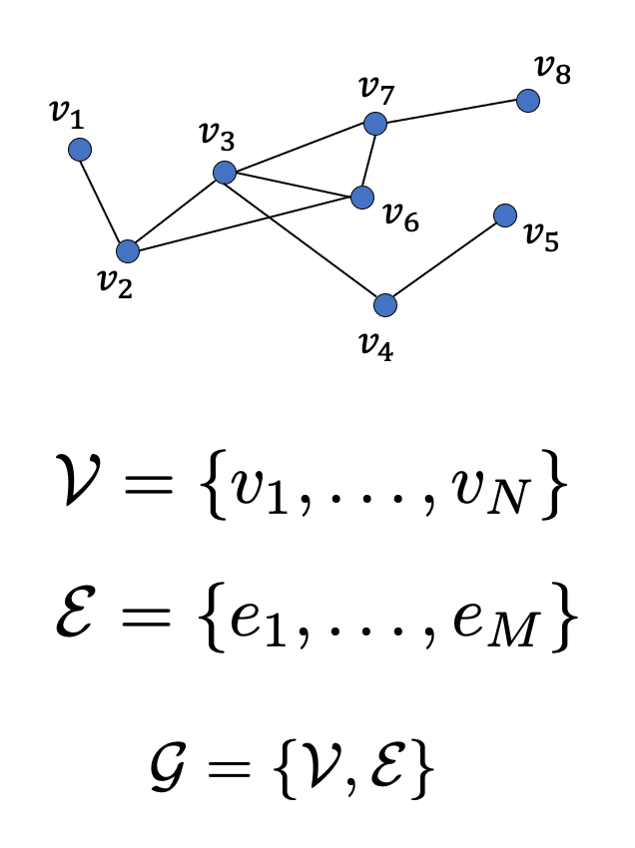
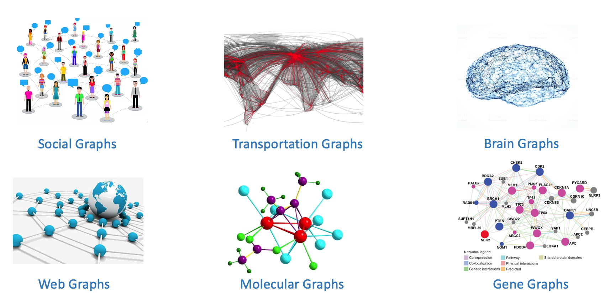
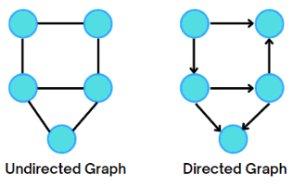
Introduction
Graph G(V, E): To represent relationships and interactions (E) between entities (V)
https://cse.msu.edu/~mayao4/tutorials/aaai2020/

Slide 4
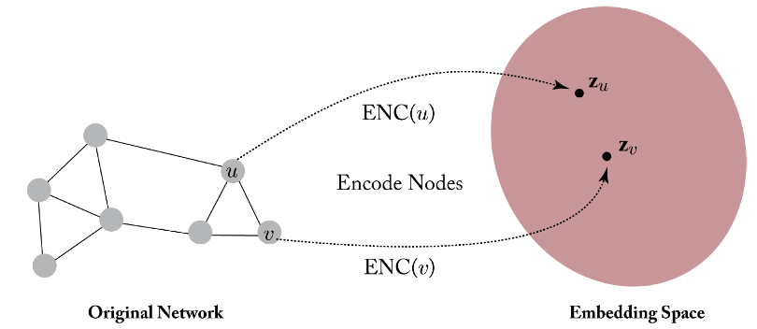
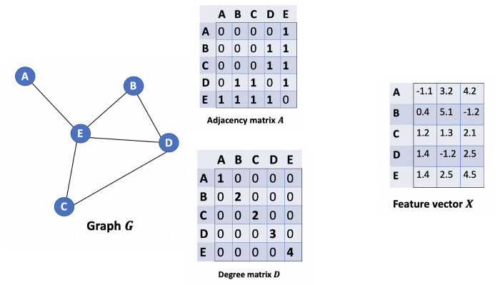
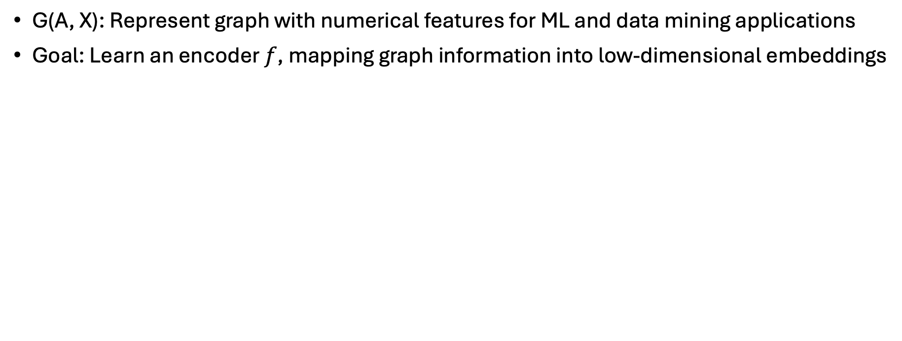

Graph Representation Learning
G(A, X): Represent graph with numerical features for ML and data mining applications
Goal: Learn an encoder $f$, mapping graph information into low-dimensional embeddings
$$d≪|V|$$
Important information preserved
https://blog.reachsumit.com/posts/2023/04/intro-to-graph-representation-learning/

Slide 5
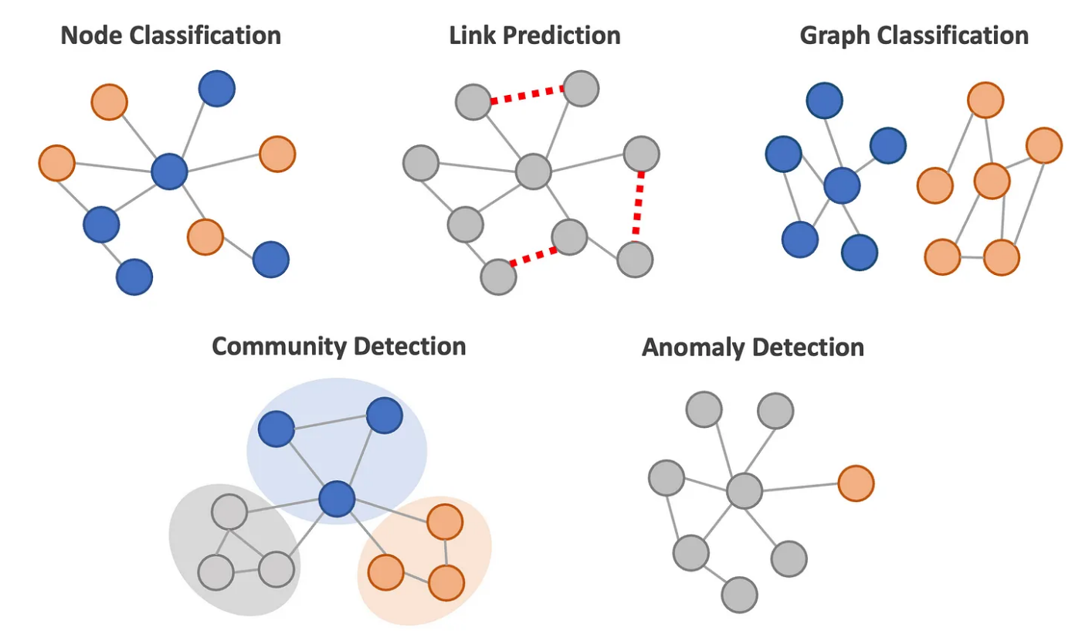
Graph Representation Applications
Node classification
Link prediction
Graph classification
Community detection
Anomaly Detection
…

Slide 6
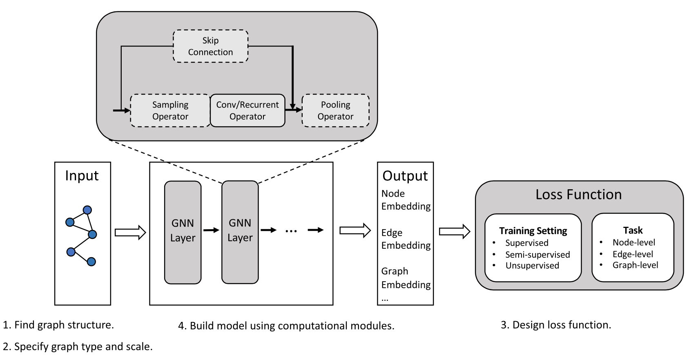
Graph Neural Networks (GNNs)
Generalize to unseen nodes, consider node/edge attributes
Message-passing scheme
Iteratively aggregating feature information from a node's neighbors
The general design pipeline for a GNN model
Zhou et al, Graph neural networks: A review of methods and applications, AI Open, Volume 1, 2020, Pages 57-81, ISSN 2666-6510,

Slide 7
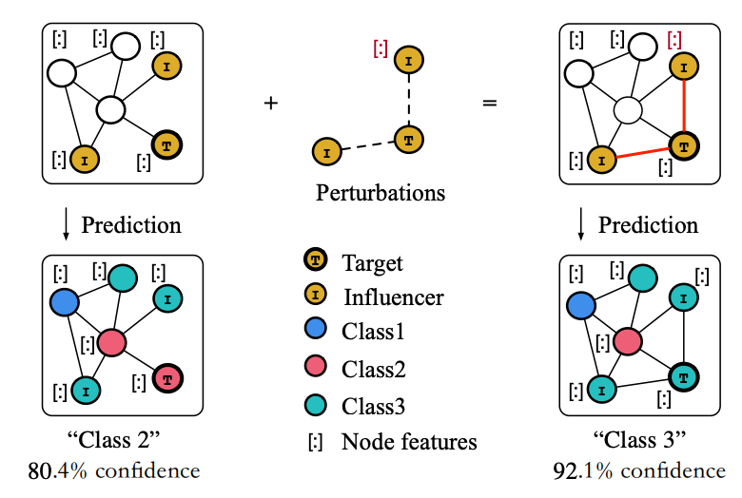
Adversarial Attack
Degrade GNN performance
Privacy and security risks
GNNs are vulnerable to adversarial attacks
A Survey of Adversarial Learning on Graphs
arXiv:2003.05730

Slide 8


Motivation
Adversarial training enhances the robustness of GNNs
Training with adversarial goals: min-max method
Training with adversarial samples
Two models:
Adversarial Graph Contrastive Learning (ARIEL): Graph contrastive learning
Property-GNN (Pro-GNN): Graph structure learning
Robust Graph Representation Learning
J. Xu et al, Robustness of deep learning models on graphs: A survey, AI Open, Volume 2, 2021, Pages 69-78, ISSN 2666-6510

Slide 9
ARIEL: Adversarial GRaph ContrastIvE Learning
Shengyu Feng, Baoyu Jing, Yada Zhu, and Hanghang Tong. 2024.
ArieL: Adversarial Graph Contrastive Learning.
ACM Trans. Knowl. Discov. Data 18, 4, Article 82 (May 2024), 22 pages.

Slide 10
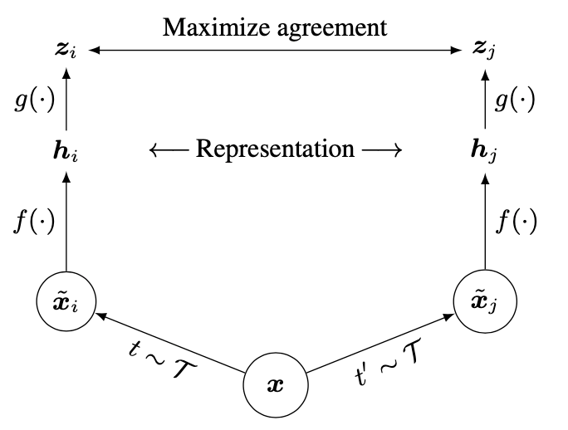
Graph Contrastive Learning
An effective self-supervised method in graph representation learning without relying on labeled data; Node-level & Graph-level
Key idea: Create positive and negative pairs, and then maximize the similarity among positive pairs and minimize the similarity with negative pairs
Chen et al. 2020. A simple framework for contrastive learning of visual representations.

Slide 11
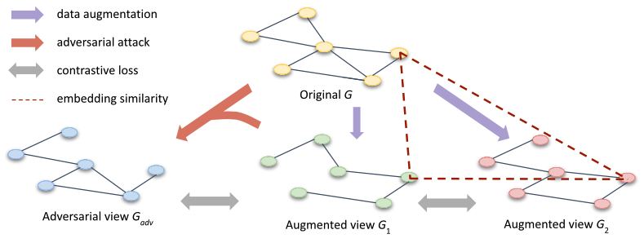
Overview of ARIEL Framework
Information Regularization

Slide 12
Objectives
Minimize the contrastive loss between the two augmented views
Minimize the contrastive loss between the adversarial view and its corresponding augmented view
Apply the information regularization to maintain training stability

Slide 13
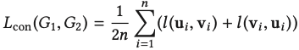
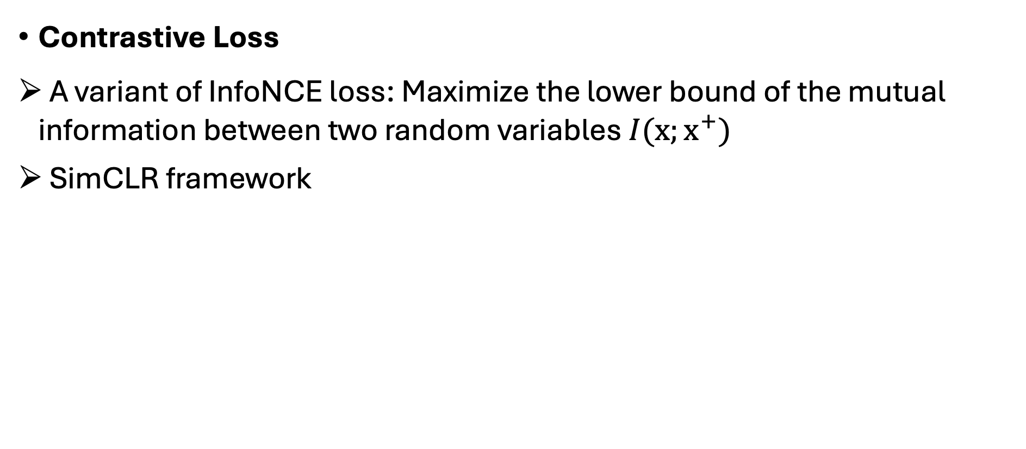
Loss Function
Contrastive Loss
A variant of InfoNCE loss: Maximize the lower bound of the mutual information between two random variables$I(x;x^{+})$
SimCLR framework

Slide 14
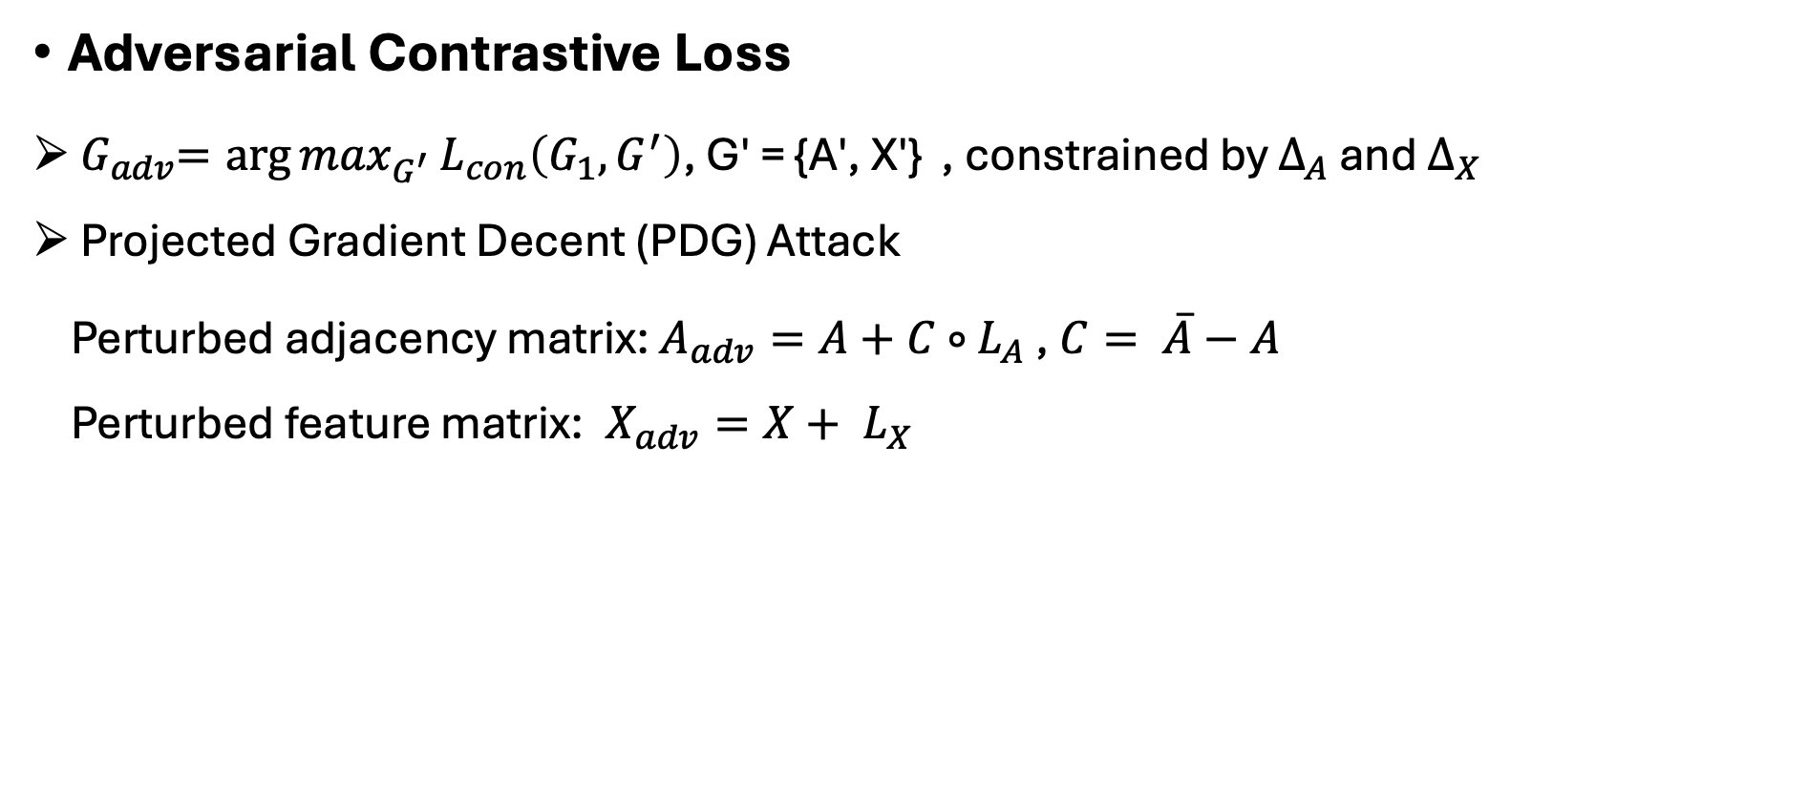
Loss Function
Adversarial Contrastive Loss
${ G}_{adv}={{\arg{max}}_{G^{′}}L}_{con}\left(G_{1}, G^{′}\right)$, G′ = {A′, X′} , constrained by $∆_{A}$ and $∆_{X}$
Projected Gradient Decent (PDG) Attack
Perturbed adjacency matrix: $A_{adv}=A+C$ $∘$ $L_{A}$ , $C= \overline{A}−A$
Perturbed feature matrix: $X_{adv}=X+ L_{X}$
$ε$₁ > 0: The adversarial contrastive loss coefficient

Slide 15
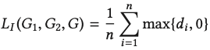
Loss Function
Information Regularization: Define the upper bound of Mutual Information based on data processing inequality and Markov relation

Slide 16
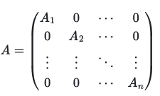
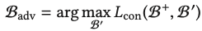
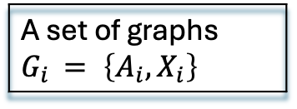
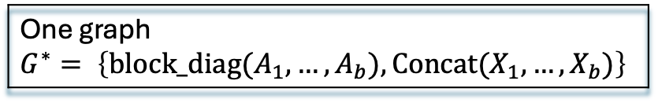
Extension to Graph-level contrastive learning
A set of graphs $G_{i }= \left\{A_{i}, X_{i}\right\}$
Combined
One graph $$G^{∗}= \left\{block_diag(A_{1}, …, A_{b}), Concat(X_{1},…, X_{b})\right\}$$
A batch of graphs B = {G₁, · · · , G_{b} }
Node dropping, Subgraph sampling
the augmentation of each graph B⁺ = {G₁⁺, · · · ,G_{b}⁺}
Edge perturbation, Feature masking
The objective of adversarial graph contrastive learning
The final loss function of ARIEL for the graph-level contrastive learning
Notes:
Embedding of each graph, granularity

Slide 17
Experiments
Evaluation: Node/Graph classification task; Robust node classification on attacked graphs
Node-level contrastive leaning | Datasets: Eight datasets--Cora, CiteSeer, Amazon-Computers, Amazon-Photo, Coauthor-CS, Coauthor-Physics, Facebook, LastFM Asia
 | Baseline: Seven graph contrastive learning methods--DeepWalk, DGI, Robust DGI (RDGI), GMI, MVGRL, GRACE, GCA; Two supervised methods—GCN, Graph Attention Network (GAT).
Graph-level contrastive learning | Datasets: TUDataset-the biochemical molecules graphs NCI1, PROTEINS, DD, and MUTAG
 | Baseline: Graph kernel methods-- graphlet kernel (GL), Weisfeiler-Lehman sub-tree kernel (WL), deep graph kernel (DGK); Unsupervised GRL methods-- node2vec, sub2vec, graph2vec, InfoGraph, GraphCL
Evaluation protocol | 10% nodes/graphs for training, 10% nodes/graphs for validation, and 80% for testing Evaluation metric: Accuracy Poisoning attack: Metattack, randomly mask out 20% of the node features and perturb 20% of the edges

Slide 18
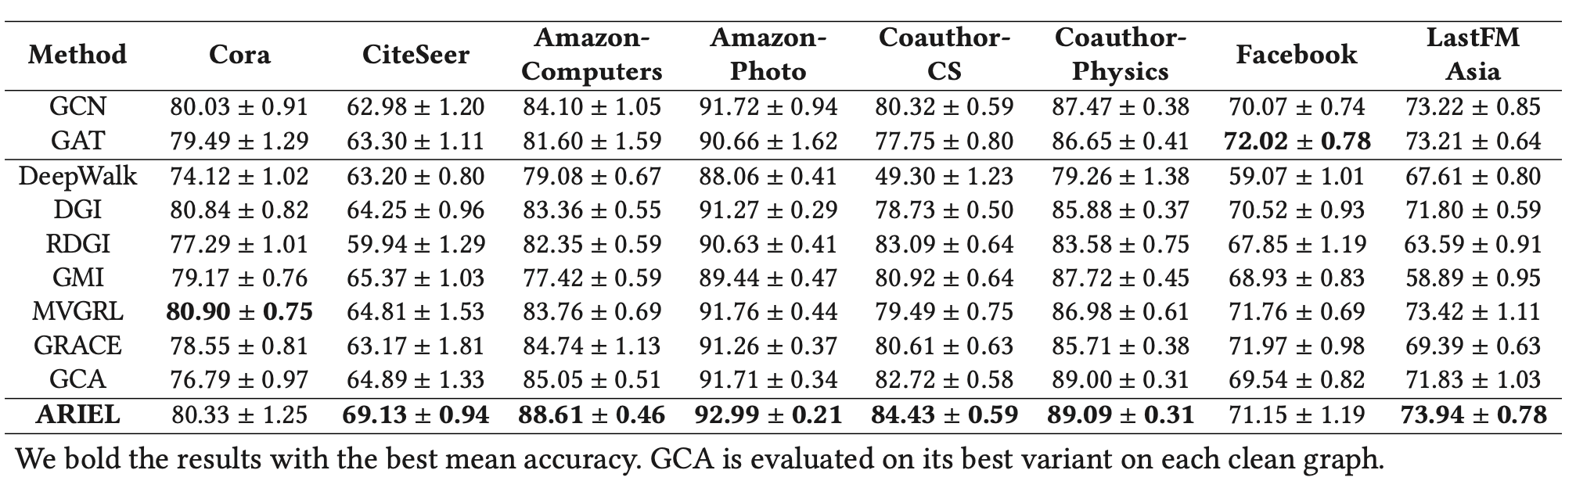
Main Results
Classification task
Node: Consistent improvement and more stable performance
Result under attack
More robust than the previous graph contrastive learning methods under an adversarial attack (Metattack)
Graph: Stronger performance
ARIEL has a better data augmentation strategy

Slide 19
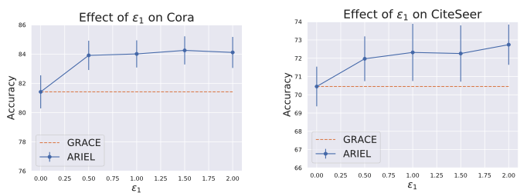
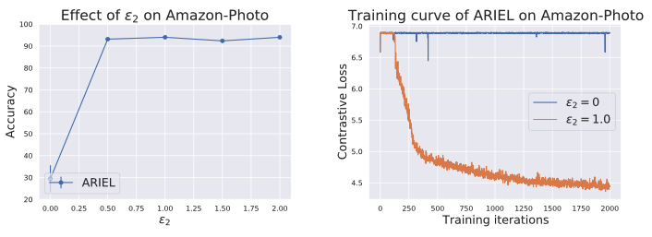
Main Results
Ablation Study
Adversarial contrastive loss coefficient $ε_{1}:$ $ε_{2}$ = 0, increase$ε_{1}$ from 0 to 2
Adversarial contrastive loss coefficient 𝜖_1: 𝜖_2 = 0, increase 𝜖_1 from 0 to 2
Information regularization $ε_{2}$: $ε_{1}$ = 0, increase $ε_{2}$ from 0 to 2
Information regularization 𝜖_2: 𝜖_1 = 0, increase 𝜖_2 from 0 to 2

Slide 20
Pro-GNN: Property-GNN
Wei Jin, Yao Ma, Xiaorui Liu, Xianfeng Tang, Suhang Wang, and Jiliang Tang. 2020. Graph Structure Learning for Robust Graph Neural Networks.
In Proceedings of the 26th ACM SIGKDD International Conference on Knowledge Discovery &amp; Data Mining (KDD '20).

Slide 21
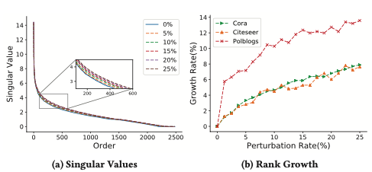
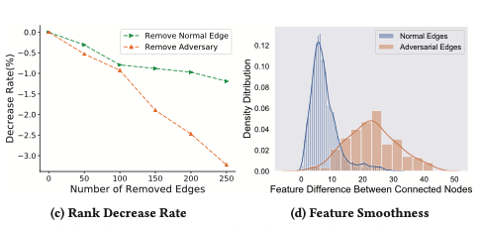
Graph Structure Learning
Graph structure properties: low-rank, sparsity, and feature smoothness
Adversarial attacks are likely to violate these graph properties
An illustrative example of the property changes by Metattack

Slide 22
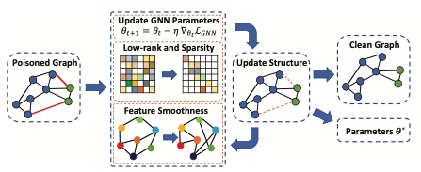
Overall Framework of Pro-GNN
Reconstruct a clean graph from a poisoned graph & Update GNN’s parameter to improve node classification performance
Given G(A,X) and partial node label Y
A poisoned by adversarial edges
Feature matrix X unperturbed
Normal Edges in black
Adversarial edges in red

Slide 23
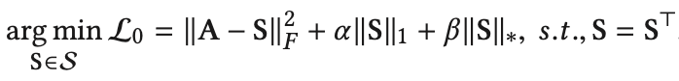
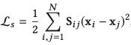
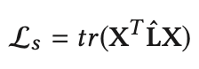
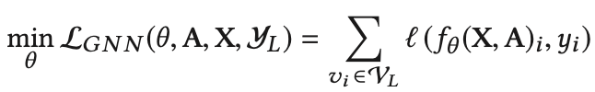
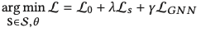
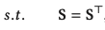
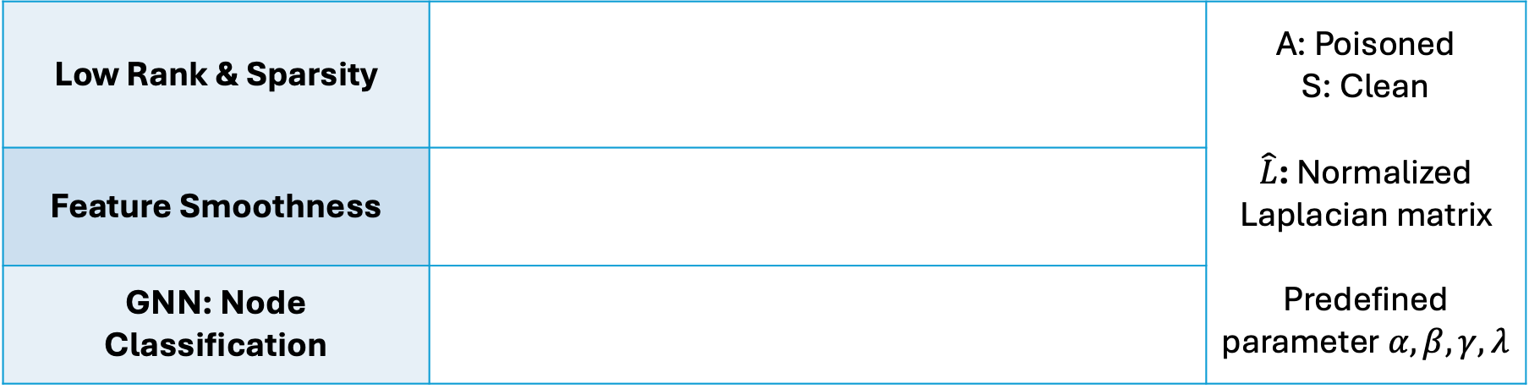
Objective Function
Low Rank & Sparsity |  | A: Poisoned S: Clean $\hat{L}$: Normalized Laplacian matrix Predefined parameter$α,β,γ,λ$
Feature Smoothness
GNN: Node Classification

Slide 24
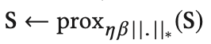
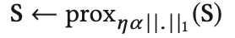
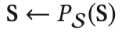
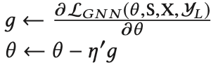
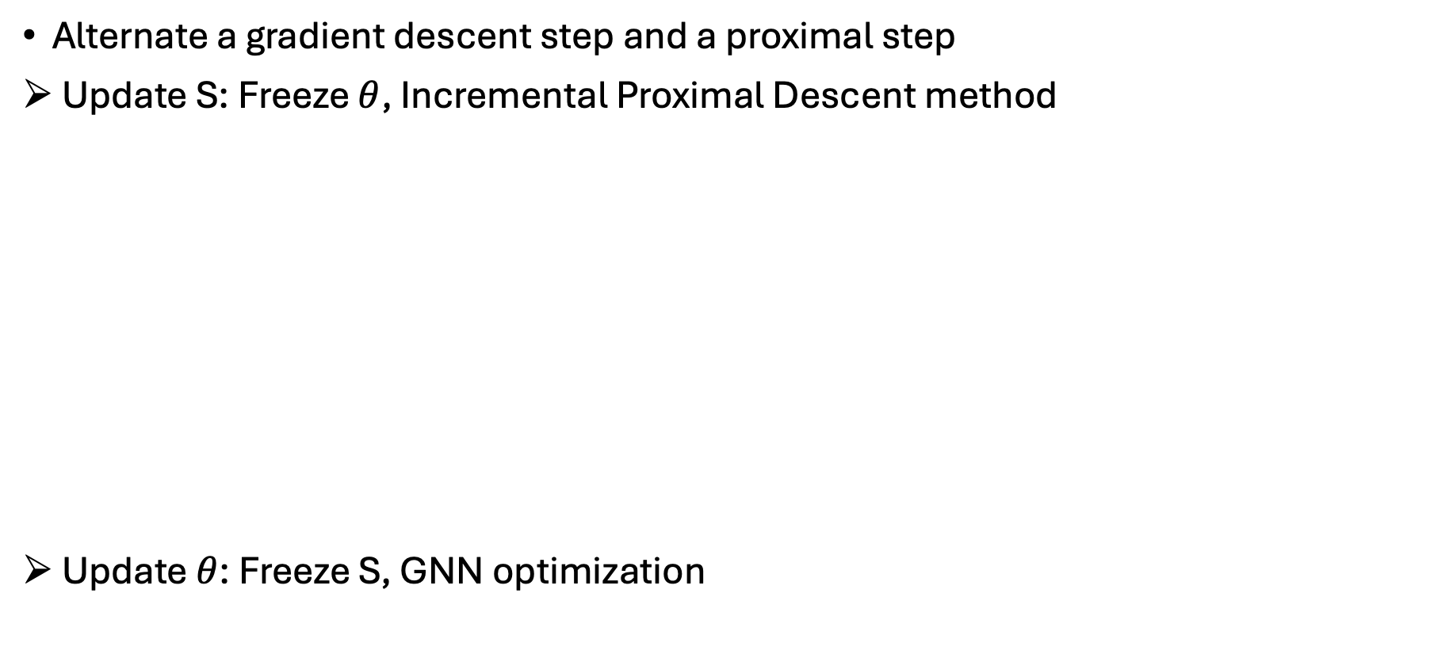
Optimization Algorithm
Alternate a gradient descent step and a proximal step
Update S: Freeze $θ$, Incremental Proximal Descent method
Update $θ$: Freeze S, GNN optimization
Differentiable
No-Differentiable
Projection

Slide 25
Experimental Settings
Four benchmark datasets | Three citation graphs: Cora, Citeseer, Pubmed One blog graph: Polblogs
Baselines | GCN, GAT, RGCN, GCN-Jaccard, GCN-SVD, Pro-GNN-fs
Node classification under attacks | Non-targeted attack: Metattack Targeted attack: Nettack Random attack
Parameter settings | 10% of nodes for training 10% of nodes for validation 80% of nodes for testing The average performance of 10 runs Different perturbation rate 0–25%

Slide 26
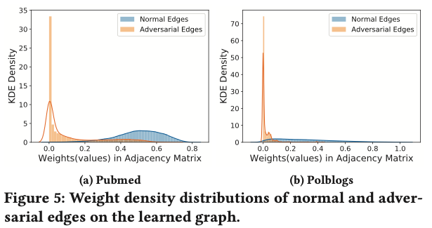
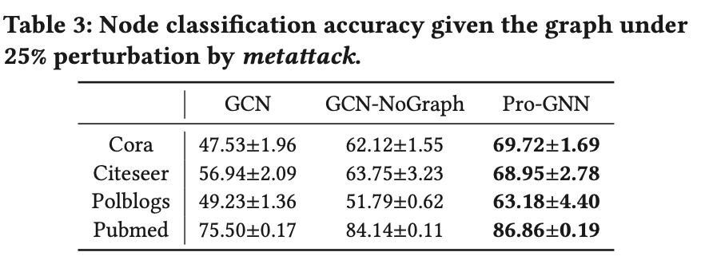
Main Results
Defense performance: Consistently outperform baseline models
Importance of Graph Structure Learning
Weights of adversarial edges are much smaller than those of normal edges in S
Learn useful structural information on heavily poisoned graph 25%

Slide 27
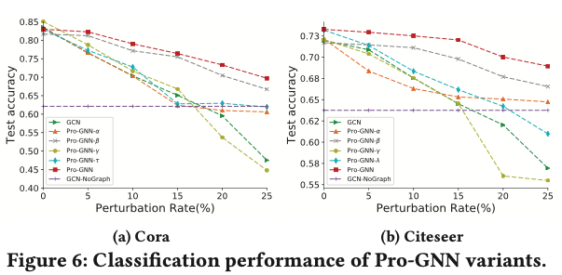
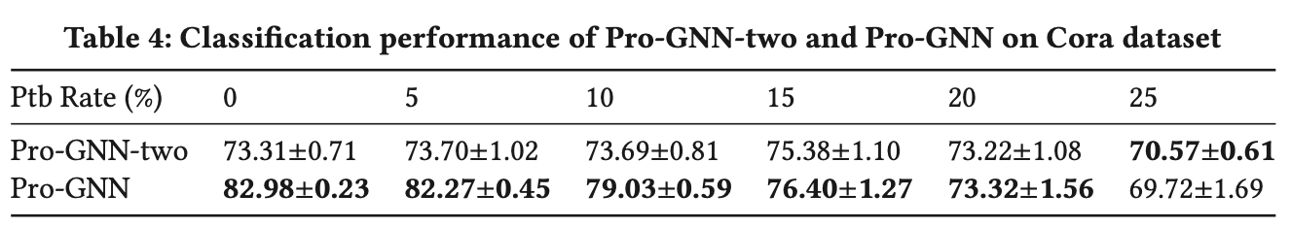
Ablation Study
Regularizers: Pro-GNN-α, Pro-GNN-β(nuclear norm), Pro-GNN-γ and Pro-GNN-λ
Two-Stage vs One-Stage

Slide 28


Comparison & Analysis
ARIEL | Pro-GNN
Graph representation learning with adversarial training: Better classification performance, Robustness against adversarial attack
Contrastive learning: Graph data-augmentation | Structure learning: Graph properties
Self-supervised More flexible and scalable | Semi-supervised
- Min-Max method -Edge & Node feature perturbation | - Adversarial sample - Edge perturbation, Node feature unchanged
Node-level & graph-level representation | Node-level representation
Diverse & larger datasets | Small datasets

Slide 29
Potential Improvements
ARIEL: Adversarial Graph Contrastive Learning
Reduce computation cost: Select a subset of anchor nodes to perturb
Information regularization: Apply to G_{adv} and G, G_{1,}G₂
Contrastive learning methods: Momentum encoder (MoCo), adaptive GCL
Adversarial augmentation: Negative mining strategy

Slide 30
Potential Improvements
Pro-GNN: Graph structure learning
Node features perturbation
Oversmoothing: Pro-GNN-fs has better performance in some experiments; DropEdge Mechanism, consistency regularization, …
Other graph properties: Clustering coefficient, degree distribution, …

Slide 31
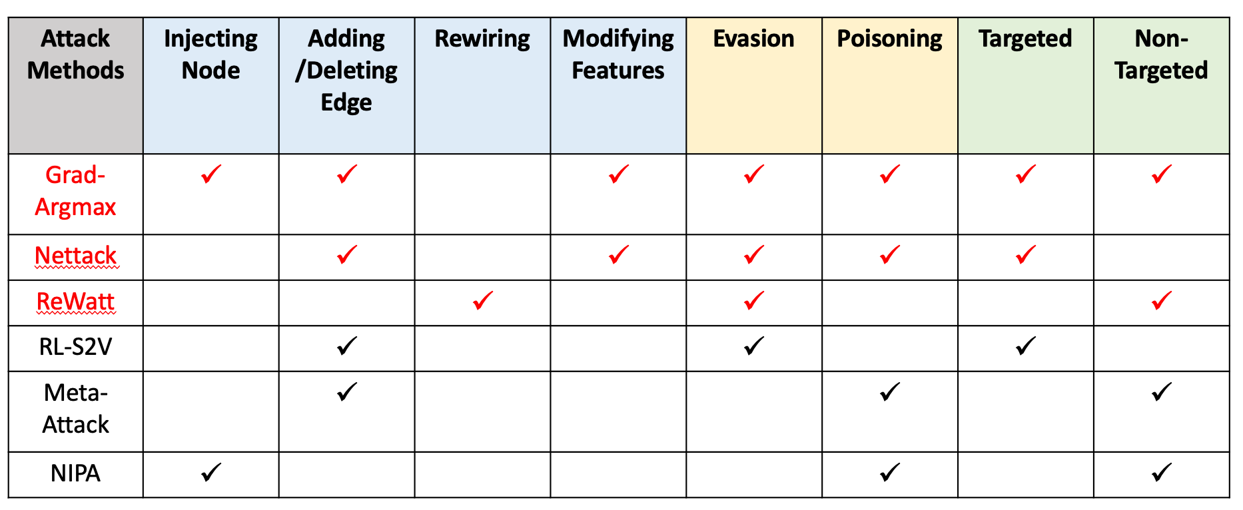
Potential Improvement
Adversarial Training: Attacks to generate adversarial view or perturb graph data
Graph encoder: Attention Mechanism (GAT), GraphSAGE…
Metrics to measure the robustness of graph models: Classification margin, adversarial gap

Slide 32
Future Works
Privacy & Security in Graph Representation Learning
Robust GNNs in Customer Segmentation and Customer Life Value Prediction
Graph Augmentation in Adversarial Graph Contrastive Learning: GANs

Slide 33


Q&A Thank you!

Slide 34
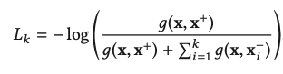
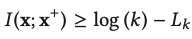
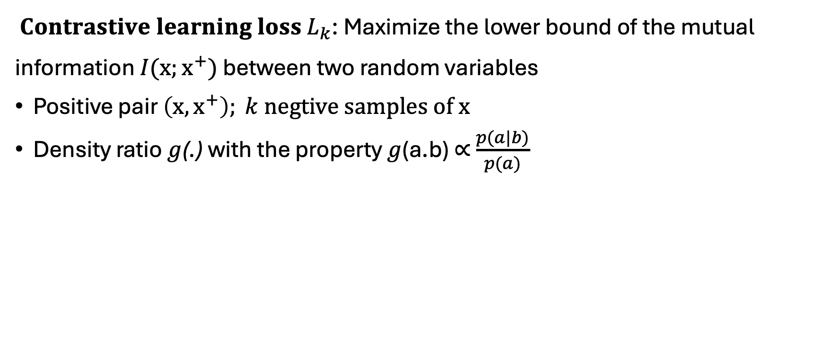
InfoNCE loss
$Contrastive learning loss L_{k}$: Maximize the lower bound of the mutual information $I(x;x^{+})$ between two random variables
Positive pair $\left(x,x^{+}\right); k negtive samples of x$
Density ratio $g$(.) with the property $g$(a.b) $∝$ $\frac{p(a|b)}{p(a)}$
Aaron van den Oord, Yazhe Li, and Oriol Vinyals. 2019. Representation Learning with Contrastive Predictive Coding

Slide 35
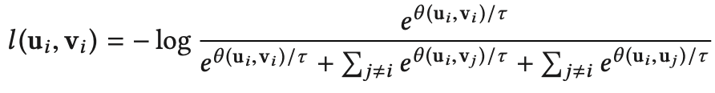
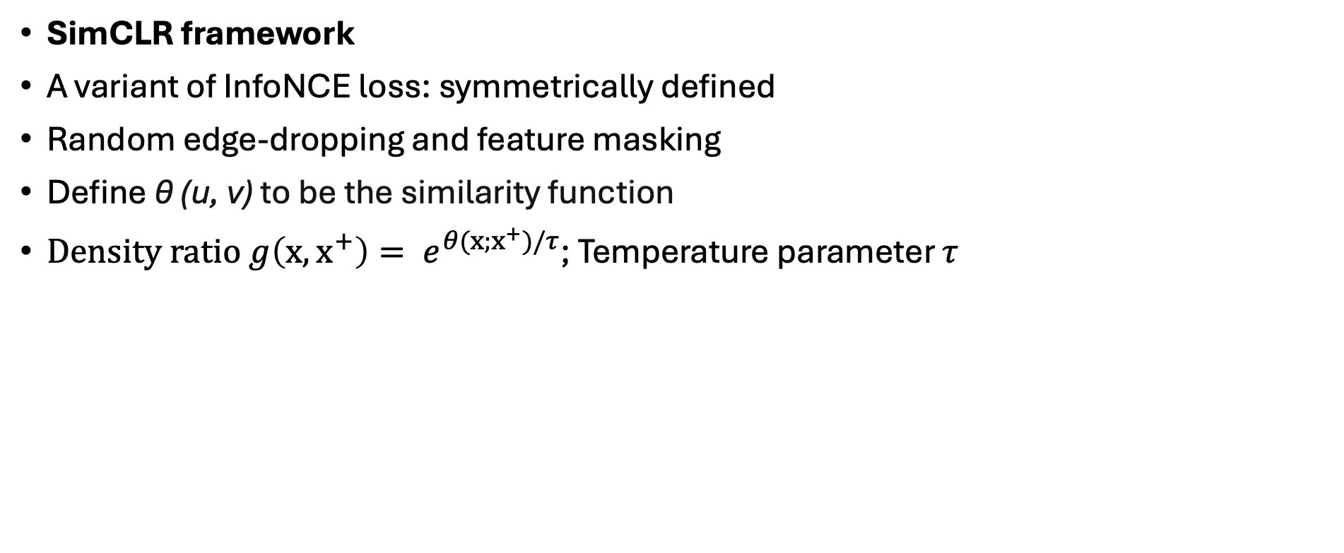
Node-level Contrastive Learning
SimCLR framework
A variant of InfoNCE loss: symmetrically defined
Random edge-dropping and feature masking
Define θ (u, v) to be the similarity function
$Density ratio g\left(x,x^{+}\right)= e^{θ(x;x^{+})/τ}$; Temperature parameter $τ$
Chen et al. 2020. A simple framework for contrastive learning of visual representations.

Slide 36
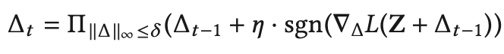
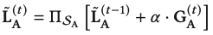
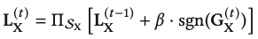



Adversarial training
Goal: $G_{adv}={{\arg{max}}_{G^{′}}L}_{con}\left(G_{1}, G^{′}\right)$, G′ = {A′, X′} , constrained by $∆_{A}$ and $∆_{X}$
Projected gradient descent (PDG) attack
Perturbed adjacency matrix: $A_{adv}=A+C$ $∘$ $L_{A}$ , $C= \overline{A}−A$, $\overline{A}=1_{n xn}$ - $I_{n} −A$
$L_{A }∈ {\left\{0,1\right\}}^{n x n}:$ Whether or not to be modified; Symmetric matrix
Perturbed feature matrix: $X_{adv}=X+ L_{X}$
Relax $L_{A}$ to convex hull ${\tilde{L}}_{A}∈ {\left\{0,1\right\}}^{n x n}$ , $S_{A}= \left\{{\tilde{L}}_{A} | \sum_{i,j}{{\tilde{L}}_{A} ≤∆_{A}, }{\tilde{L}}_{A} ∈ {\left[0,1\right]}^{n x n}\right\}$
$S_{X}= \left\{L_{X}| {\left\|L_{X}\right\|}_{∞}{≤δ_{X},L_{X}∈R}^{n x d}\right\}$
Xu et al. 2019. Topology attack and defense for graph neural networks: an optimization perspective.

Slide 37

Information Regularization
Goal: Address training collapse and regularize the instance similarity
Markov relation $Z_{1 }→ Z_{2 }→ Z_{3} ⇒I\left(Z_{1; }Z_{3}\right)≤ I\left(Z_{1; }Z_{2}\right)$
Theorem. For two graph views, $G1 and G2 ,$independently transformed from graph G, the density ratio of their node embeddings H₁ and H₂ should satisfy $g(H2[i, :], H1[i, :]) ≤ g(H2[i, :], H[i, :])$, and $g(H1[i, :], H2[i, :]) ≤ g(H1[i, :], H[i, :]),$ where $H$ is the node embeddings of the original graph.

Slide 38

Training Method
Augmentations: Random edge-dropping and feature masking
Subgraph sampling G_{s}: Avoid heavy computation; Increase randomness
Curriculum learning: For every T epoch, $ε$₁ is multiplied by a weight γ, γ > 1
$ε$₁ > 0: The adversarial contrastive loss coefficient

Slide 39



Algorithm of Ariel
1
2
3
1
2
3

Slide 40

Pro-GNN Training Algorithm
Projection operation P_{S}(S)
S_{ij} ∈ [0,1], project S_{ij} < 0 to 0 and S_{ij} > 1 to 1

